Slide 1

Juicy Mathematical Problems
Bartłomiej Brzozowski

Slide 2
Presentation Plan
Problem 1 – The Distance between two points in unit square
Problem 2 – The Monty Hall Paradox
Problem 3 – Mathematical Induction
Conclusions and Recomendations.

Slide 3
Problem 1 – The Distance between two points in unit square
We have a square of side 1. What is the average distance between two points in this square?
Let's draw a square of side 1 and introduce a coordinate system so that the whole square is in the first quadrant of the system and one of its points is at the origin.

Slide 4


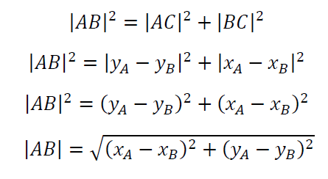
Of course we have
and
From the Pythagorean theorem we get the equation:

Slide 5
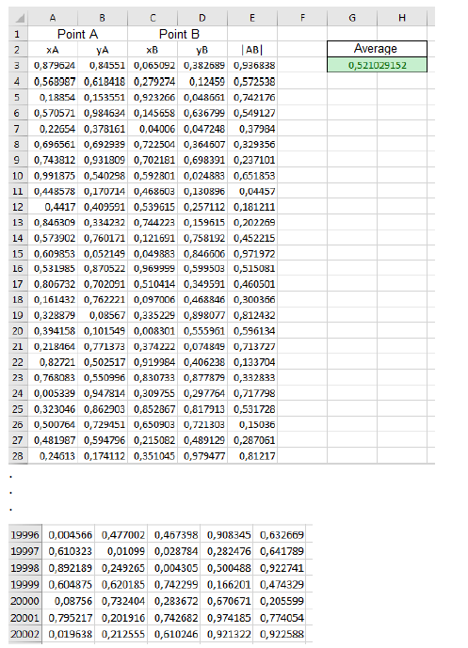


In the "Average" field, therefore, there is an approximate value of the average distance between two points in a unit square. The exact solution to this problem is
and results from the calculation of the integral

Slide 6
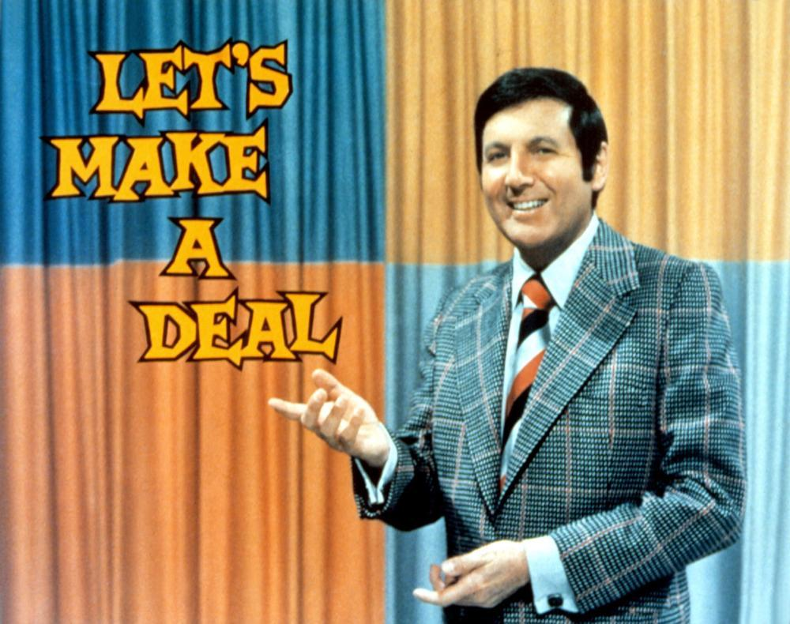
Problem 2 – The Monty Hall Paradox
We have three doors to choose from. There is nothing behind two of them, and behind one there is a prize. After selecting the door, one of the remaining ones is removed (necessarily the ones with no reward). At this point, we have the option to stay with the original choice or change the decision. What should be done to maximize the probability of winning?

Slide 7
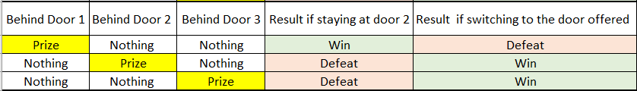
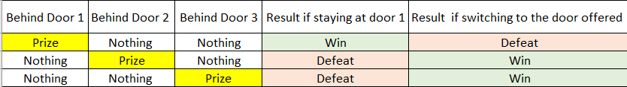
Let's consider every possible course of the game, assuming we choose door 1 at the beginning.

Slide 8

Problem 3 – Mathematical Induction
How to prove the truth of an infinite number of statements depending on a natural number?
We are given a sequence of statements dependent on
Mathematical induction proceeds as follows:
let's prove the theorem ,
let us assume that the theorem is true for fixed
let us prove that from the truth of the theorem follows the truth of the theorem

Slide 9


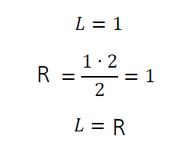

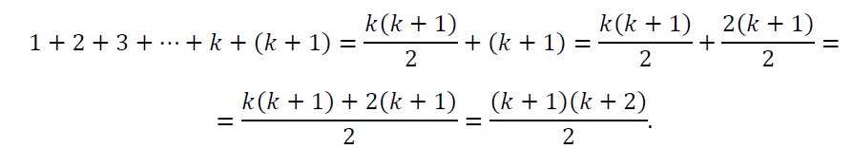


A simple example of how mathematical induction works
Example. For any equality occurs:
1. Let us check that the formula holds for
2. Suppose the formula is true for , i.e.
3. Let's check if then the formula is true for
q.e.d.

Slide 10
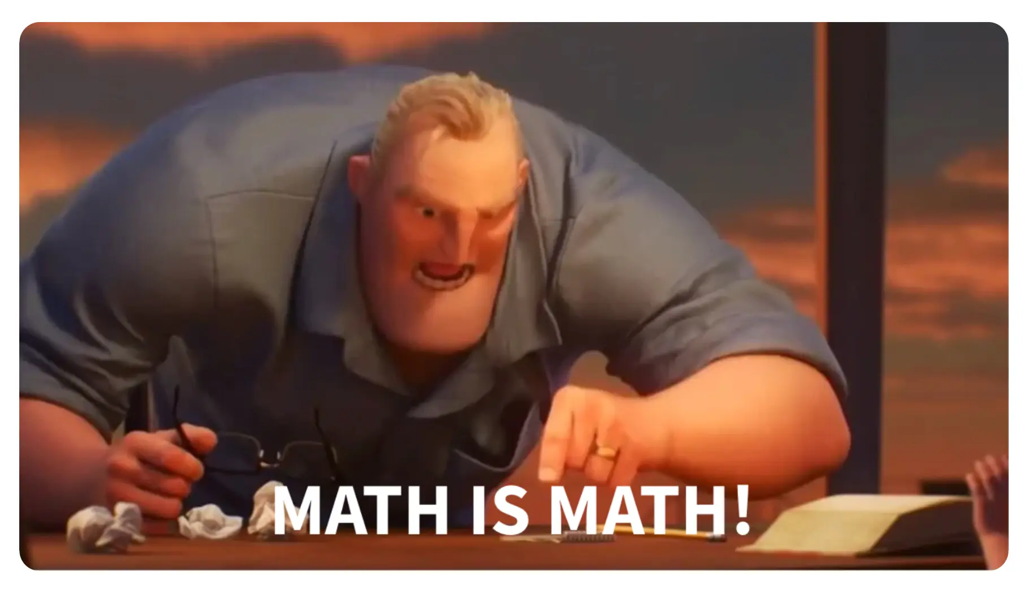
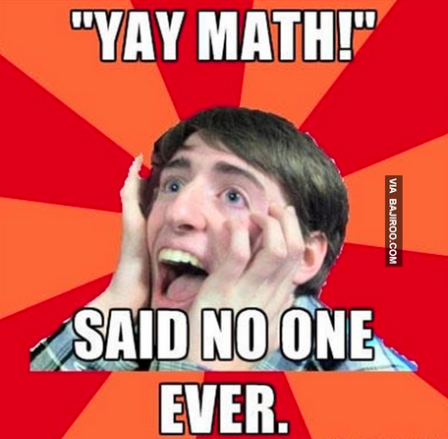
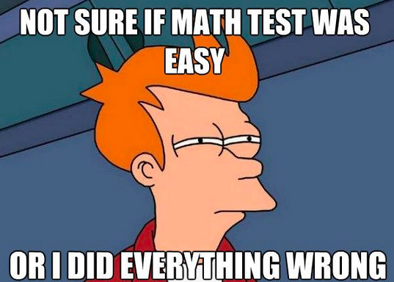
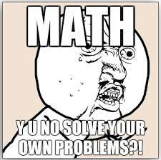
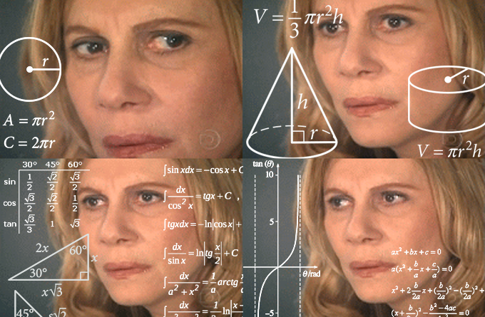
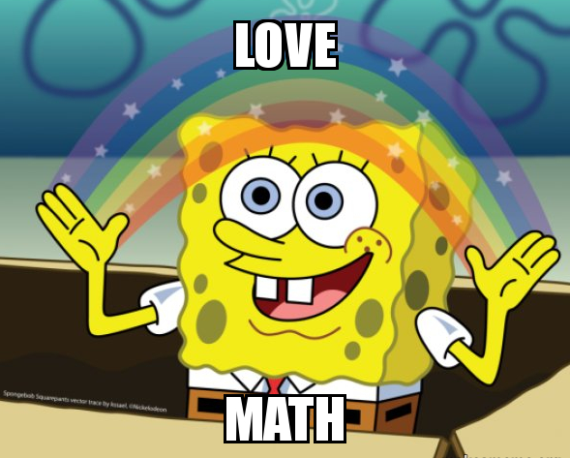
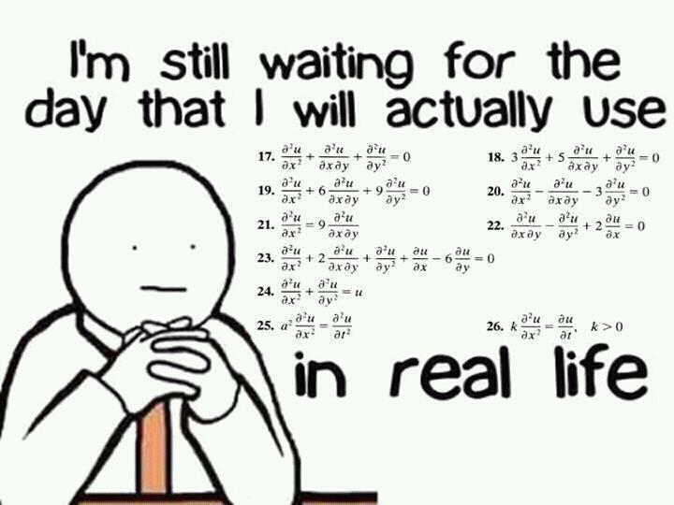
Conclusions and Recomendations

Slide 11
Thank you J

